Slide 1
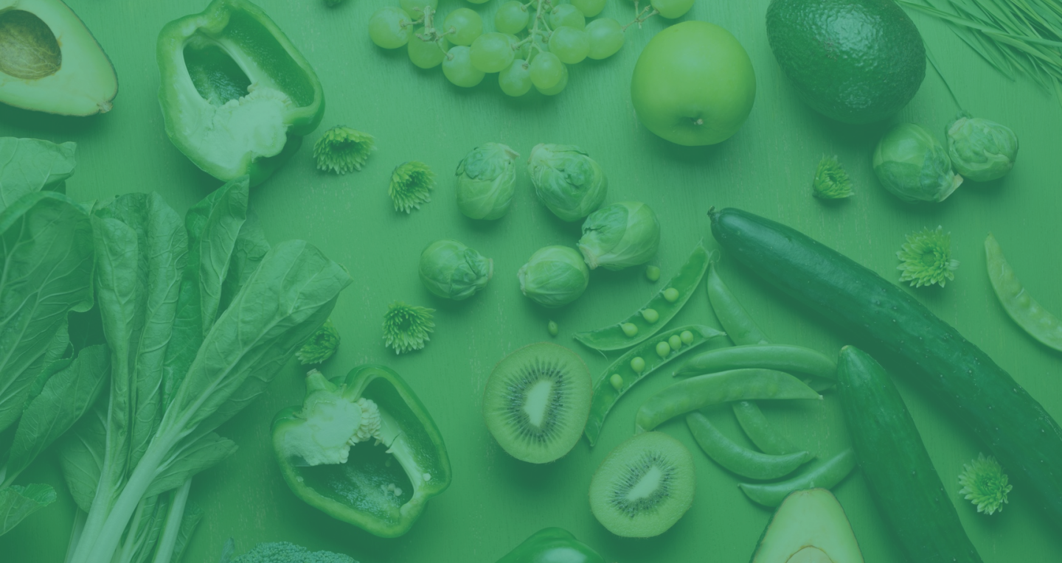

Courtney Ripoll, Cassandra Keesee, Kaylee Andrews, Amy Suh, Chang Yan, Han-Ping Lin, Krithika Sekhar

Slide 2
W HAT IS FRESHSPIRE ?

Slide 3




Freshspire is a web-app connecting food distributors with excess produce to buyers, rerouting food that would otherwise be wasted.
Food distributors often have excess produce.
They can post their reduced-cost produce to the Freshspire web-app.
Restaurants and other businesses can buy produce at discounted prices.
Notes:
Rachel
Overstocking; produce that is rejected due to imperfections

Slide 4
OUR GOALS
Previous iteration connected grocery stores to consumers
New focus on connecting local food distributors to restaurants
To develop a restaurant facing front-end for the Freshspire application
Login, view local deals, requests/orders, payment, etc.
To adjust the previous iteration’s backend to fit the new needs of the company

Slide 5
OUR APPROACH
Build a PWA (Progressive Web Application), which is cross-platform.
Front-End:
Create-react-app for scaffolding the SPA (single page application)
React.js, for the view library
React-router, for routing across components
Sass, a CSS preprocessor for styling
Back-End:
Java, Spring, Maven, with test implemented with JUnit, etc
This week, we are focusing on Front-End.

Slide 6
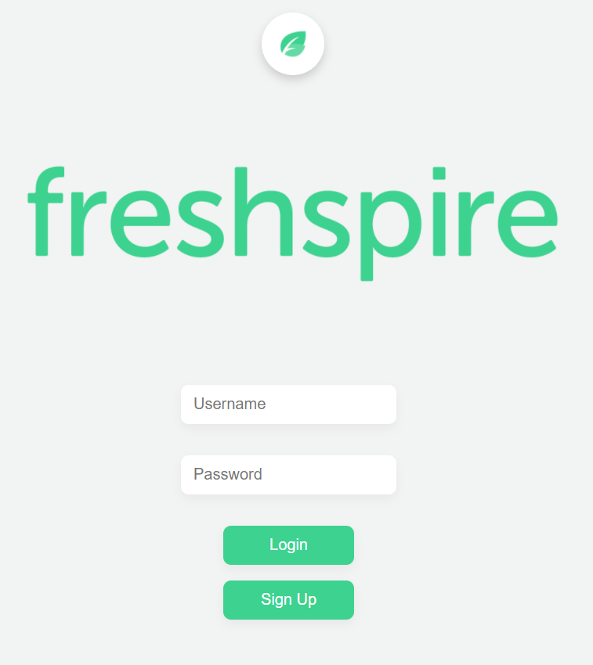
LOGIN AND MENU
Kaylee, Amy, Courtney and Cassie
Front-End login screen
Hamburger menu upon login
Back-End to connect to View Deals page

Slide 7
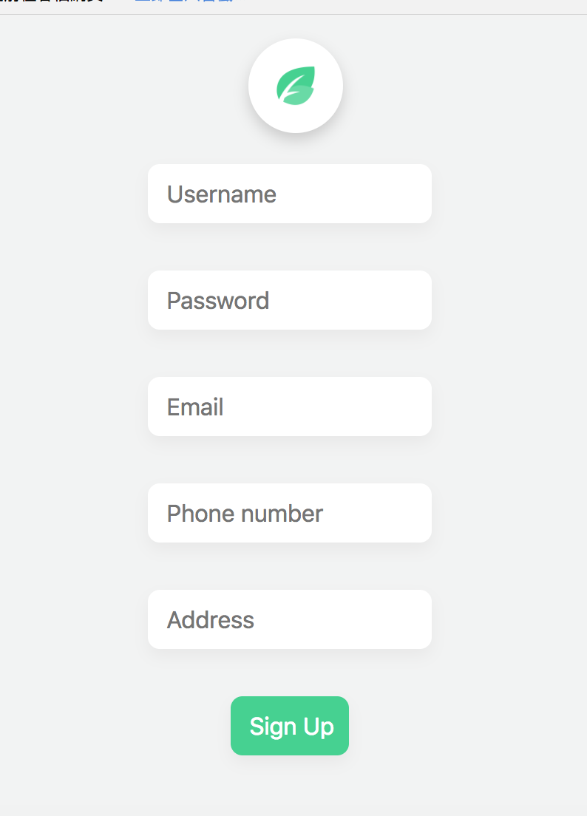
SIGN UP FORM
Ping and Krithika
Sign-up with
Username
Password
Email
Phone number
Address

Slide 8
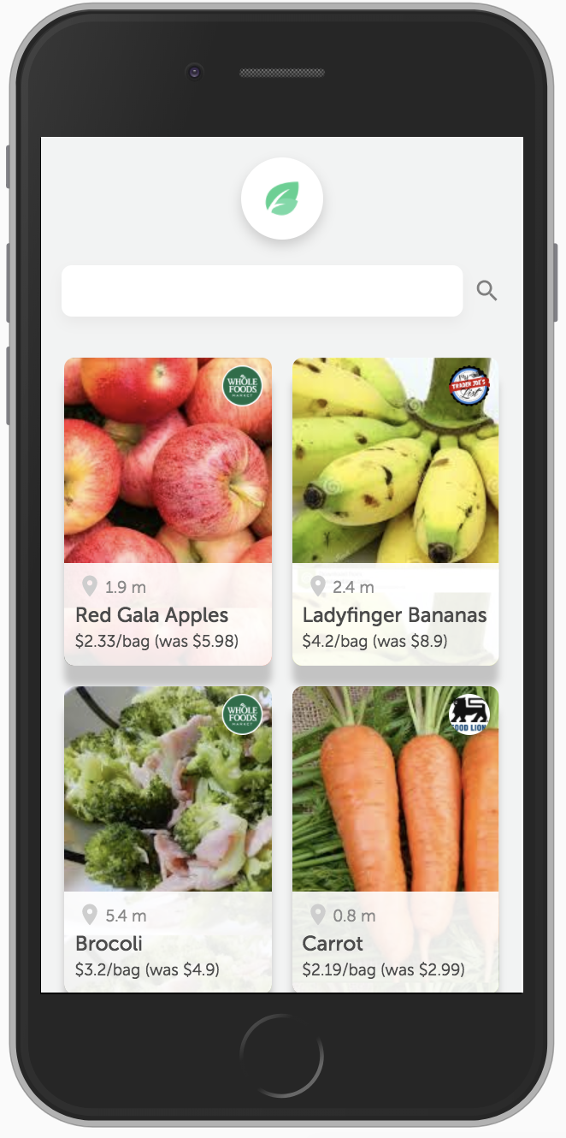
VIEW DEALS
Chang
Features
Search bar
Deal thumbnail:
Name of the deal
Distance
Price comparison

Slide 9
QUESTIONS?
Freshspire graphics & resources used with permission from Shraddha Rathod

